Slide 1
Customer Price Awareness: A Case Study
TANVEER AHMED
L4 TECHNICAL PROFESSIONAL TELUS
Customer Price Awareness: A Case Study

Slide 2
Problem Identification & Exploration Process
Problem Statement: Customers in Alberta with more than one active TELUS service are unaware of the recent Mobility service price increase despite being notified via SMS 6 weeks prior.
Exploration Process:
1. Data Collection & Integration:
a. Collect Data: Gather data on all sent SMS notifications, delivery reports, and customer call logs.
b. Integrate Data: Use SQL and Python to merge datasets (e.g., customer profiles, SMS delivery data & logs).
2. Data Analysis:
a. EDA (Exploratory Data Analysis): Utilize data science libraries (e.g., Pandas, Matplotlib) to identify patterns in customer complaints.
b. Sentiment Analysis: Perform NLP analysis on call logs to understand customer sentiment and common issues.
3. Hypothesis Testing:
SMS Delivery Issues: Investigate if SMS notifications were delivered successfully. Disparity in SMS Delivery for AB Customer?
Customer Segmentation: Analyze if certain customer segments (e.g., multiple services, region-specific) are more affected.
Customer Price Awareness: A Case Study

Slide 3
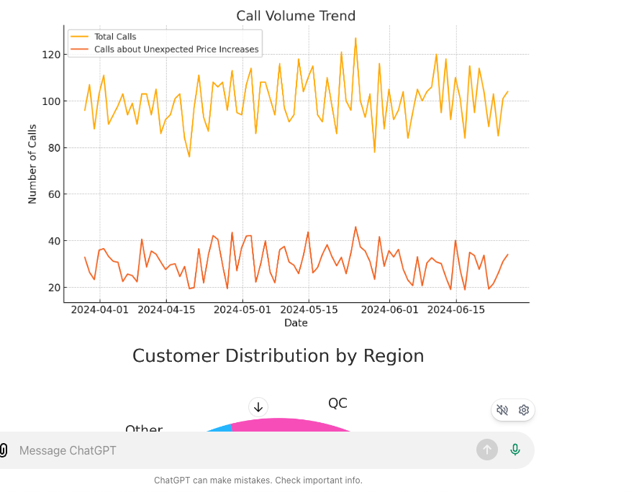
Sudden Influx in Call Volume June 2024
Customer Price Awareness: A Case Study

Slide 4
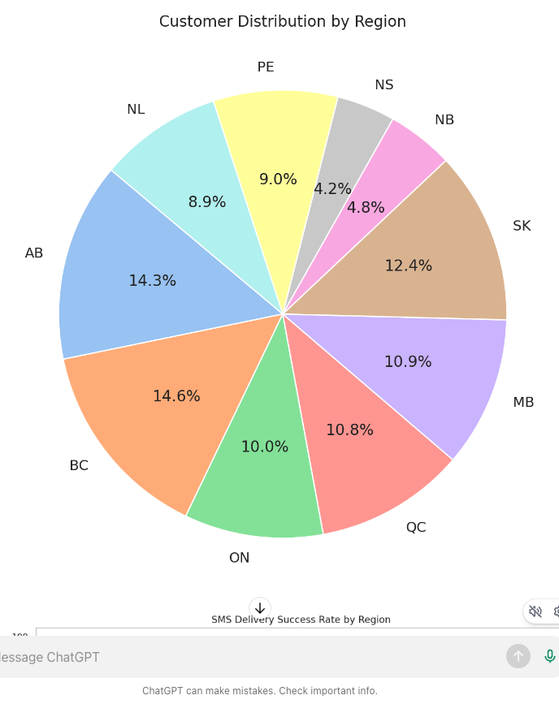
Telus Customer Distribution by Region
Customer Price Awareness: A Case Study

Slide 5
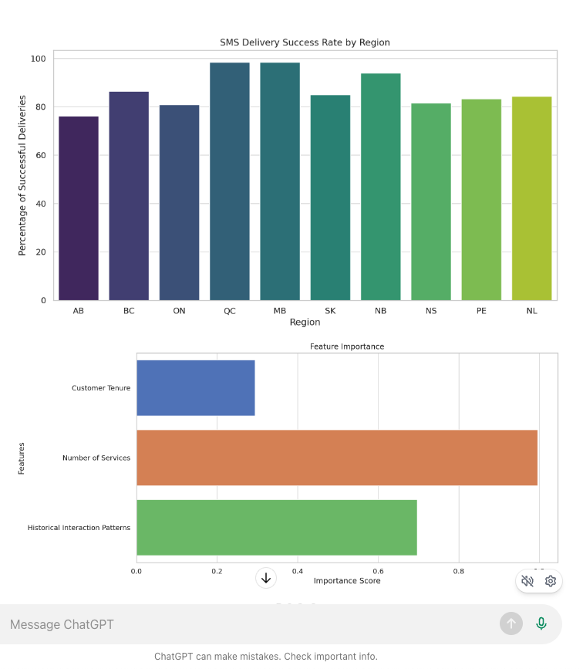
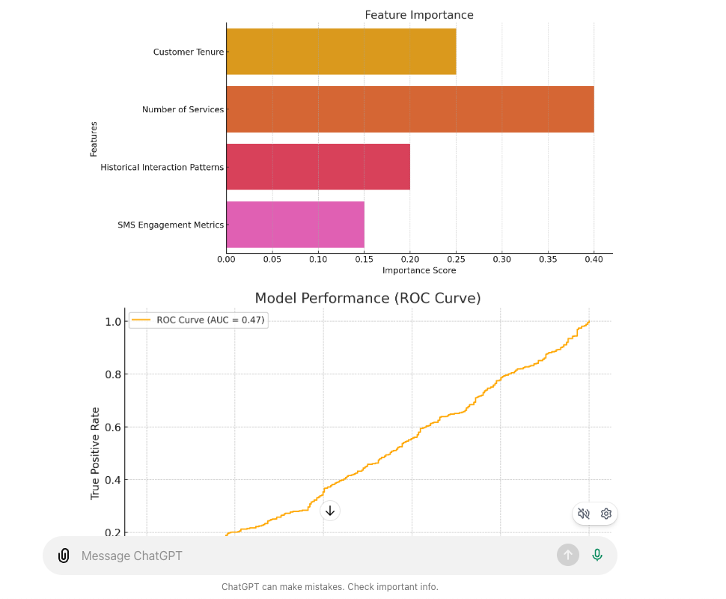
Key Data Insight: Customers Who Were Affected
Customer Price Awareness: A Case Study

Slide 6
PoC: Proposed Solution
1. Multi-Channel Notification Strategy:
a. SMS, Email, App Notifications: Ensure redundancy in communication by sending notifications via both SMS, email & My Telus App.
b. Customer Portal Alerts: Display price increase alerts prominently on the My Telus App.
c. Augmented Reality (AR) Notifications: Use AR technology to send interactive notifications that customers can view on My Telus App using their smartphones. This can include visual explanations of the price increase.
d. Voice Assistants: Integrate notifications with popular voice assistants like Alexa and Google Assistant to provide audible reminders of the upcoming price changes.
2. Personalized Communication:
a. AI-Powered Personalization: Leverage AI to tailor notifications based on customer preferences on My Telus App.
b. Behavioral Nudges: Use behavioral science principles to craft messages that effectively capture attention and prompt customers to take action (e.g., confirming they have read the message).
3. Enhanced Customer Interaction:
a. Interactive Chatbots: Deploy chatbots in My Telus App that can answer questions about the price increase and provide additional information through natural language conversations.
b. Gamification: Introduce gamification elements in notifications (e.g., quizzes or challenges related to the price increase) to engage customers and ensure they are aware of the changes.
Customer Price Awareness: A Case Study

Slide 7
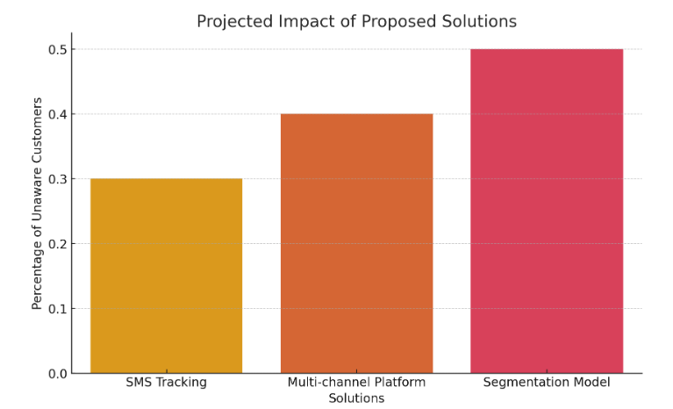
Proposed Solution Projected Impact
Customer Price Awareness: A Case Study

Slide 8
POC Implementation
Technical Implementation:
1. Data Pipeline Enhancement:
a. Build Pipelines: Create robust data pipelines using cloud platforms to ensure seamless integration and delivery of notifications.
b. Automate Notifications: Implement automation for sending multi-channel notifications using APIs and cloud functions.
2. Monitoring & Feedback Mechanism:
a. Real-Time Monitoring: Use cloud-based monitoring tools (e.g., Google Cloud Monitoring) to track delivery and open rates of notifications.
b. Feedback Integration: Develop a feedback loop to capture customer responses and continuously improve the notification process.
3. Machine Learning Insights:
a. Predictive Analysis: Use ML models to predict which customers are likely to miss notifications and proactively send reminders.
b. Anomaly Detection: Implement ML-based anomaly detection to identify and address any issues in the notification process.
Collaborative Efforts:
Cross-Functional Teams: Work with marketing, IT, and customer service teams to ensure a cohesive approach to customer communication.
Stakeholder Buy-In: Present the POC to stakeholders and secure alignment on the implementation roadmap.
Customer Price Awareness: A Case Study

Slide 9
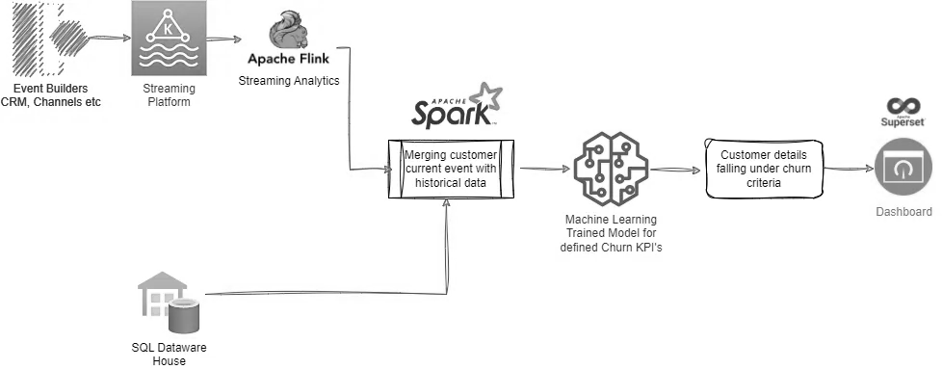
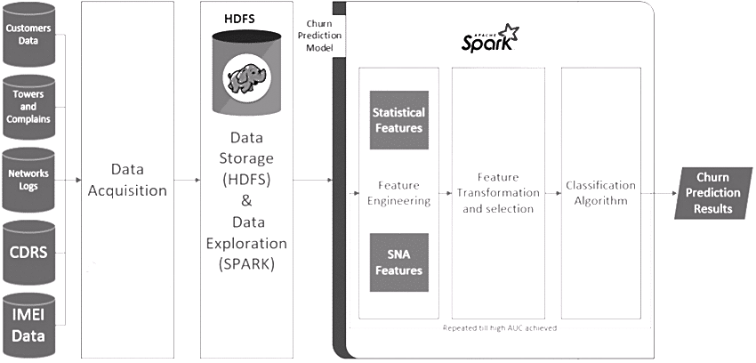
POC Model Architecture
Customer Price Awareness: A Case Study

Slide 10
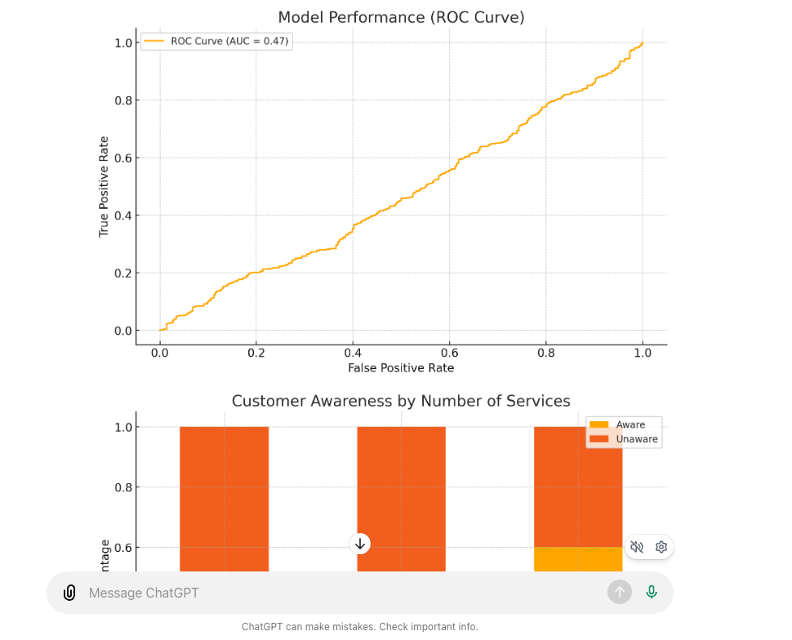
Proposed Model Performance
Customer Price Awareness: A Case Study

Slide 11
Expected Outcomes & Next Steps
Expected Outcomes:
1. Increased Customer Awareness: Higher visibility and acknowledgment of price increases through multi-channel notifications.
2. Reduced Call Volume: Fewer customer complaints and calls related to unawareness of price changes.
3. Enhanced Customer Satisfaction: Improved customer experience and satisfaction by ensuring timely and clear communication.
Next Steps:
1. Pilot Program:
a. Launch Pilot: Implement the multi-channel notification strategy in a small customer segment to test effectiveness.
b. Gather Data: Collect data on notification delivery, open rates, and customer feedback during the pilot phase.
2. Full-Scale Implementation:
a. Roll Out: Expand the implementation across all customer segments based on pilot results.
b. Continuous Improvement: Use machine learning insights and customer feedback to refine and optimize the notification process.
3. Ongoing Monitoring:
a. Performance Tracking: Continuously monitor the effectiveness of the notification strategy using cloud-based tools.
b. Regular Updates: Provide regular updates to stakeholders on the progress and outcomes of the implemented solution.
Customer Price Awareness: A Case Study

Slide 12
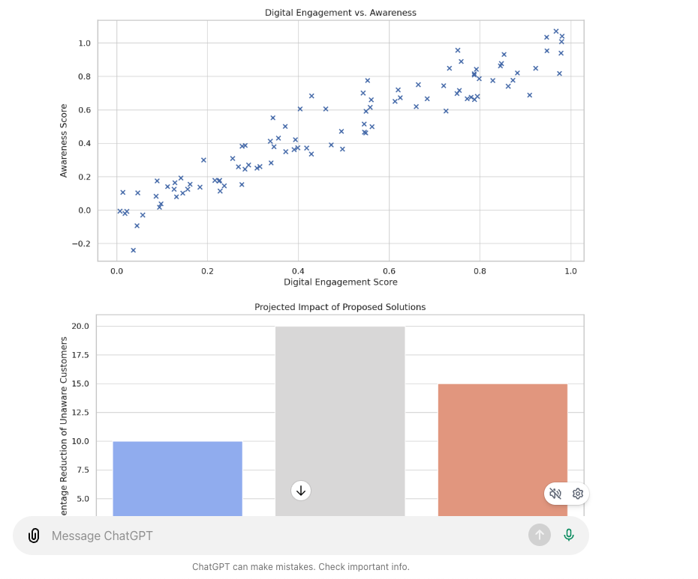
Digital Engagement Score
Why are customers unaware of price increases? Why 1: They didn't receive the SMS
Why 2: Lower delivery rate in AB
Why 3: Carrier issues specific to AB
Why 1: They received but didn't read the SMS
Why 2: Low engagement with Mobility communications
Why 3: Information overload for multi-service customers
Customer Price Awareness: A Case Study

Slide 13
Challenges and Future Enhancement
Challenges:
Potential customer turnover
Competitor offers and aggressive marketing
Future Enhancements:
Immediate Actions (1-2 Weeks)
Proactive Communication: (Develop AI System to identify at risk customers)
Short Term Actions (3-4 Weeks)
Value Added Services: (Loyalty Program Benefits for long term customers)
Medium Term Actions (2-3 Months)
Flexible Pricing Options: (Deploy ML for usage patterns/ Deploy Build your own bundle)
Long Term Actions (4-6 Months)
Customer Feedback Loop: (Deploy NLP for Sentiment Analysis)
Retention Focused Customer Service: (Deploy Chatbot using Conversational AI)
Competitive Analysis: (Monitor competitor offers in real time & generate counter offers). Use time series to predict future trends.
Customer Price Awareness: A Case Study

Slide 14
Solution Stack
Technology Stack:
GAN: (TextGAN, PyTorch)
Database: (SQL)
Machine Learning: (scikit-learn, PySpark)
Cloud: (GCP BigQuery, Apache Airflow), Version Control (Git)
Data Processing and Visualization: (pandas, numpy, matplotlib, seaborn)
Containerization: (Docker, Kubernetes),
Backend API: (Flask)
Framework Stack:
DMAIC: (State, Quantify, Identify, Solution, Monitor)
DDDM Framework: (Identify, Collect, Analyze, Interpret, Decision)
CRISP-DM: (Cross-Industry Standard Process for Data Mining)
5 WHYs & 7S Framework:
SWOT Analysis:
Customer Journey Mapping:
Customer Price Awareness: A Case Study

Slide 15
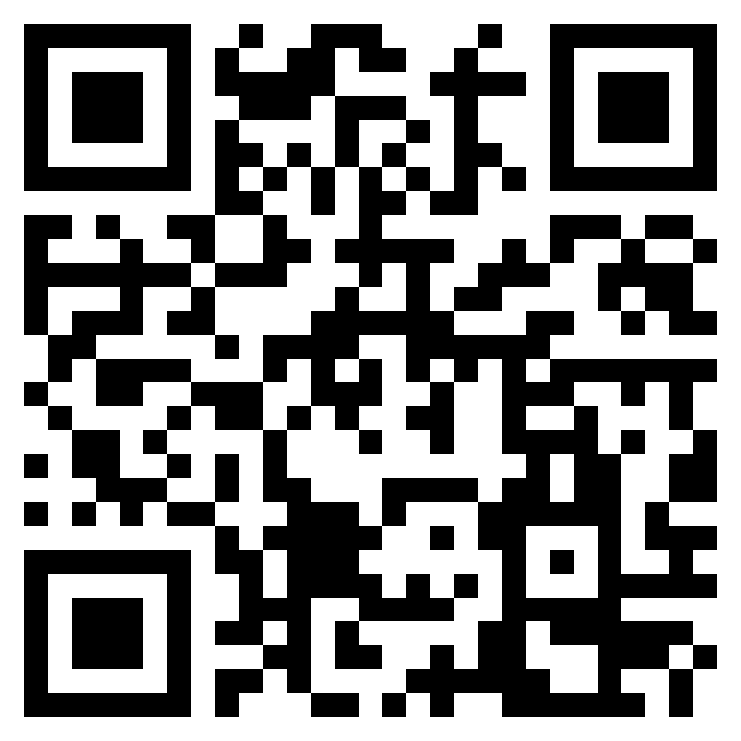
GitHub Code Repository
GitHub Repository
[https://github.com/tanveermemon92/TELUS-L4.git]
Code Access: The entire codebase, is available in the repository.
Implementation Details: Detailed README file provides instructions for installation & usage.
Executable Prototype: Clone the repository and follow the instructions to run the prototype locally.
Scan Me
Customer Price Awareness: A Case Study

